Slide 1

Web Development Presentation
Presented by : Dilawar Hussain
Computer Engineering Dep
UET Lahore | 2024
Notes:
To change the image on this slide, select the picture and delete it. Then click the Pictures icon in the placeholder to insert your own image.

Slide 2
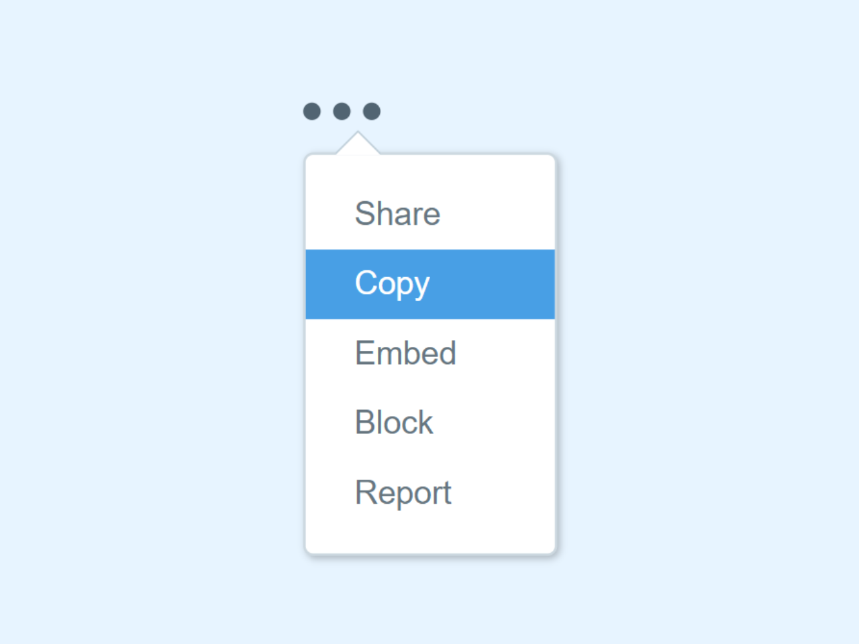
CSS Dropdown:
What is the CSS Dropdown ?
Dropdown box that appears when the user moves the mouse over an element.

Slide 3
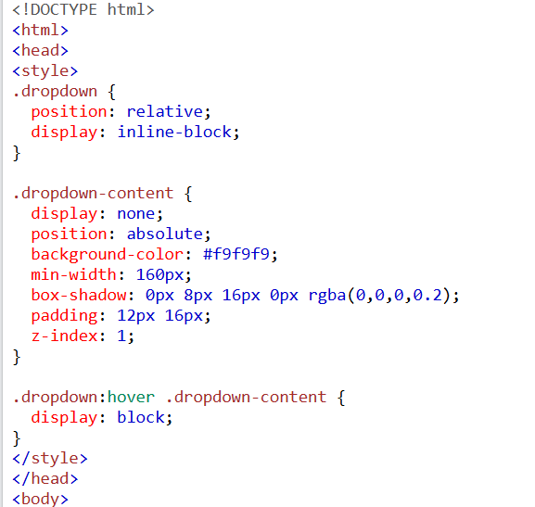
Why it is important:
Enhanced User Experience
Space Management
Improved Accessibility
Seamless Interaction

Slide 4
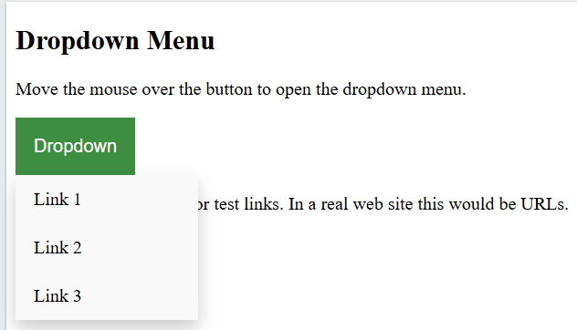
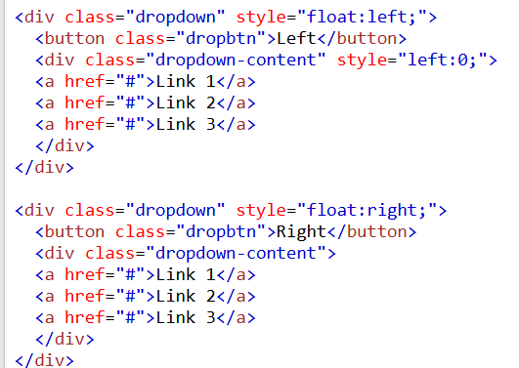
Dropdown Menu:
Dropdown menu that allows the user to choose an option from a list
Right-aligned Dropdown Content

Slide 5
Live Examples of Dropdown:
Step 1 Title
Step 2 Title
Step 3 Title
Step 4 Title

Slide 6
Form in the CSS
Form is essential for collecting user input, and styling them with CSS can enhance their appearance and usability

Slide 7
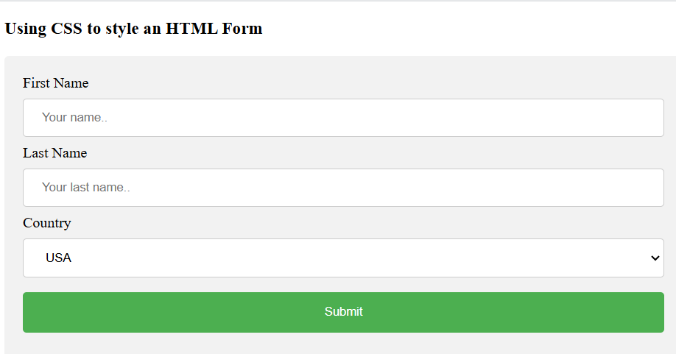
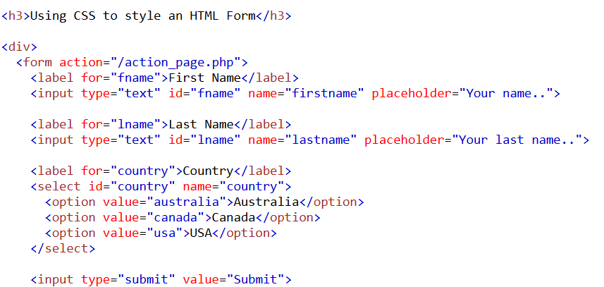
Example:

Slide 8
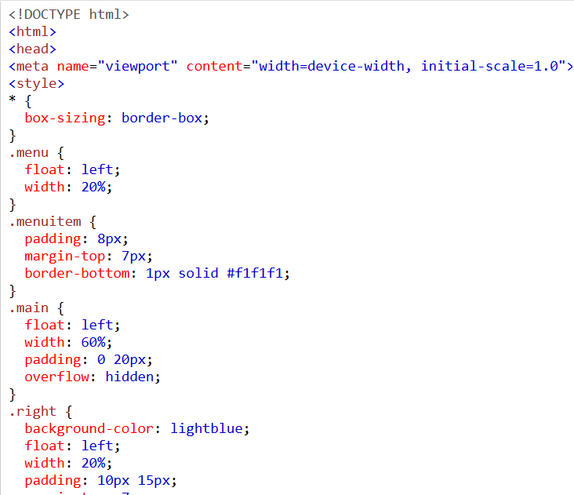
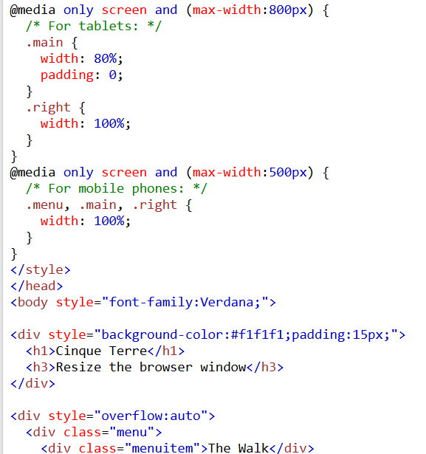
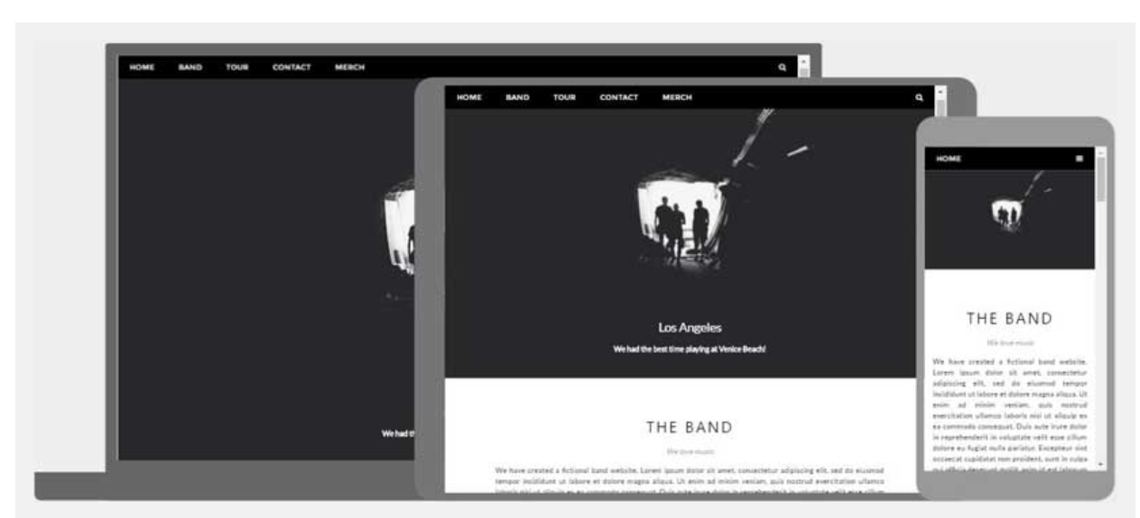
HTML Responsive Web Design:
It is about creating web pages that look good on all devices. It will automatically adjust for different screen sizes and viewports.

Slide 9
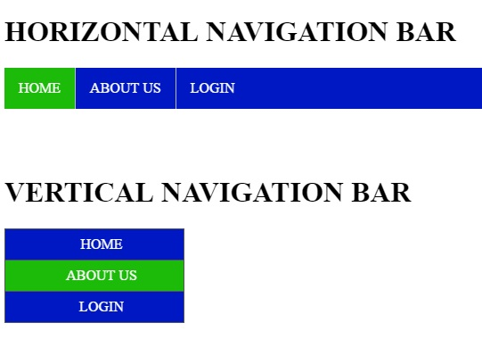
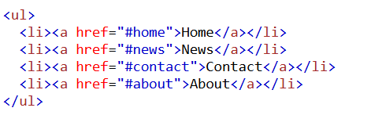
CSS Navigation bar:
It allows users to navigate through a website's main pages or sections.
Types:
Horizontal and Vertical

Slide 10
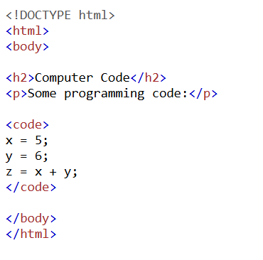
HTML Computer Code:
HTML contains several elements for defining user input and computer code
We have diff format of the computer code like.
HTML <kbd> For Keyboard Input
HTML <samp> For Program Output
HTML <var> For Variables

Slide 11


Slide 12
Add a Slide Title - 7

